Slide 1
RAY TRACING IN ONE WEEKEND: THE BOOK SERIES
Notes by Yuxing Shi
https://raytracing.github.io/

Slide 2
Ray Tracing in One Weekend
https://raytracing.github.io/books/RayTracingInOneWeekend.html

Slide 3
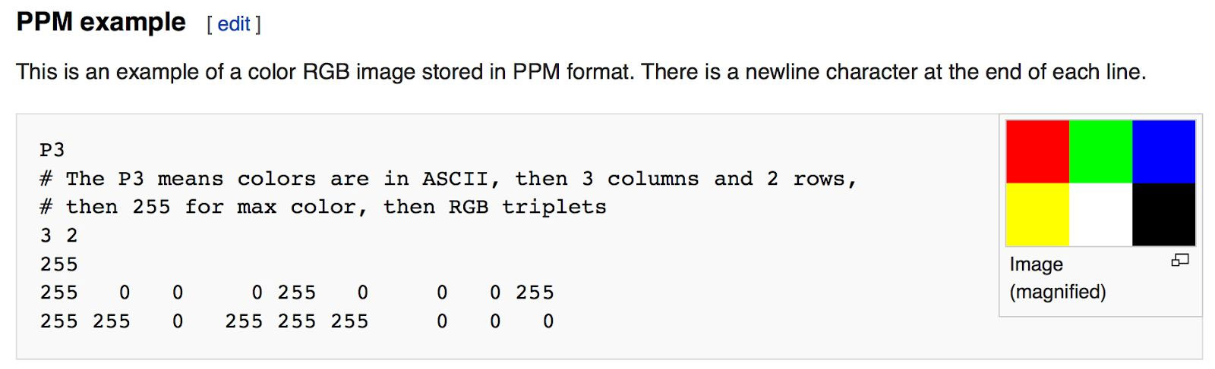
Output an Image
The PPM Image Format

Slide 4
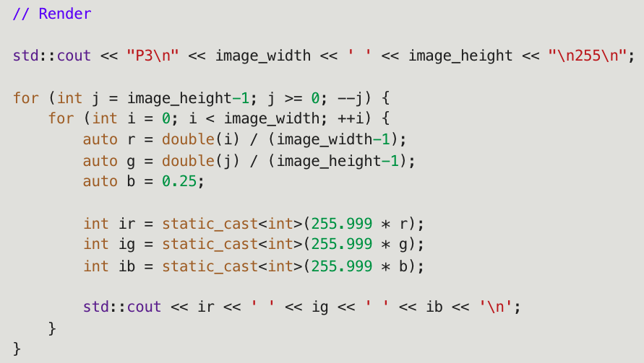

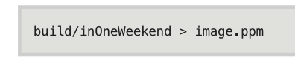

Progress Indicator

Slide 5
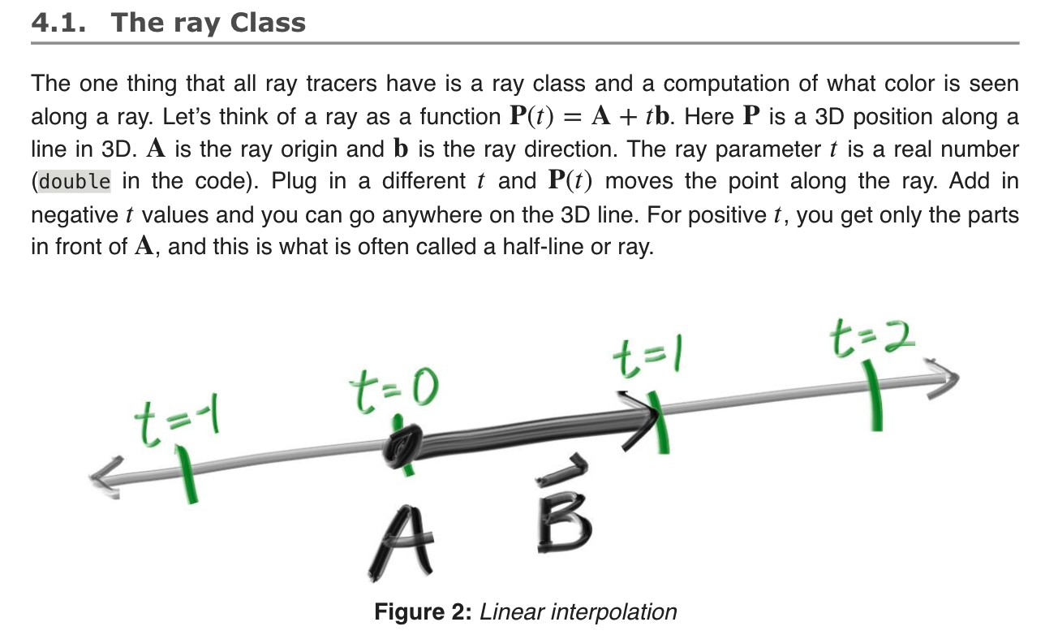
Rays, a simple camera, and bg.

Slide 6
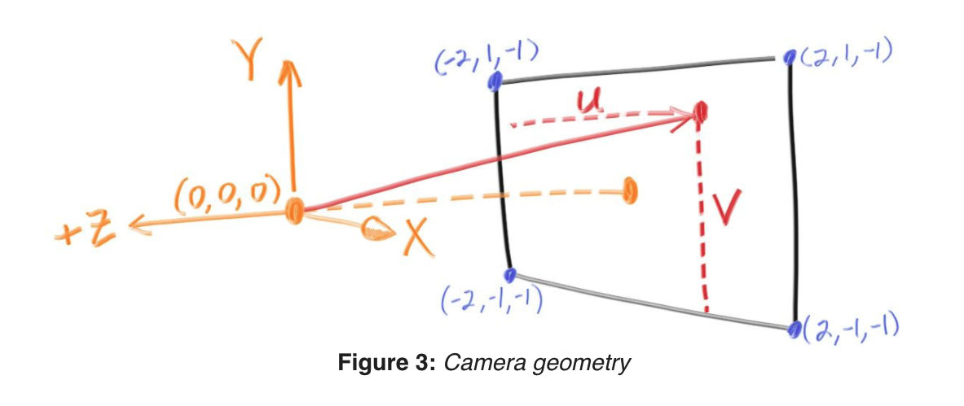
Sending Rays Into the Scene
(1) calculate the ray from the eye to the pixel,
(2) determine which objects the ray intersects, and
(3) compute a color for that intersection point.
Focal length = 1 unit (orange)
!= focus distance

Slide 7
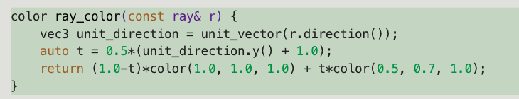
Codes
Viewpoint
through which to pass our scene rays
aspect ratio should be the same as our rendered image
Rectangle height of 2 at last slide.
Focal length: projection point to projection plane.
linearly blends white and blue depending on the height of the 𝑦 coordinate after scaling the ray direction to unit length (-1 ~ 1)
And then scale 0 <= t <= 1.0

Slide 8
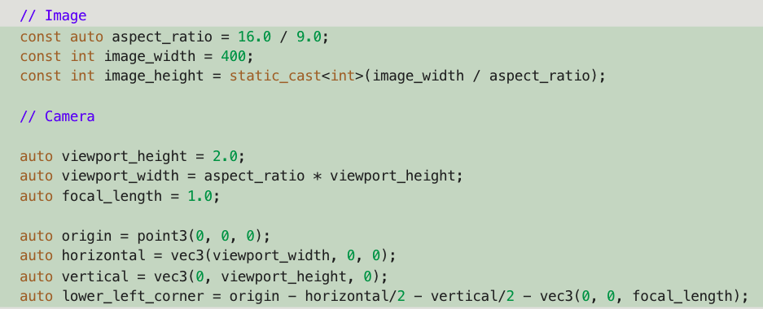
Codes
Image + Camera (+ Render)

Slide 9
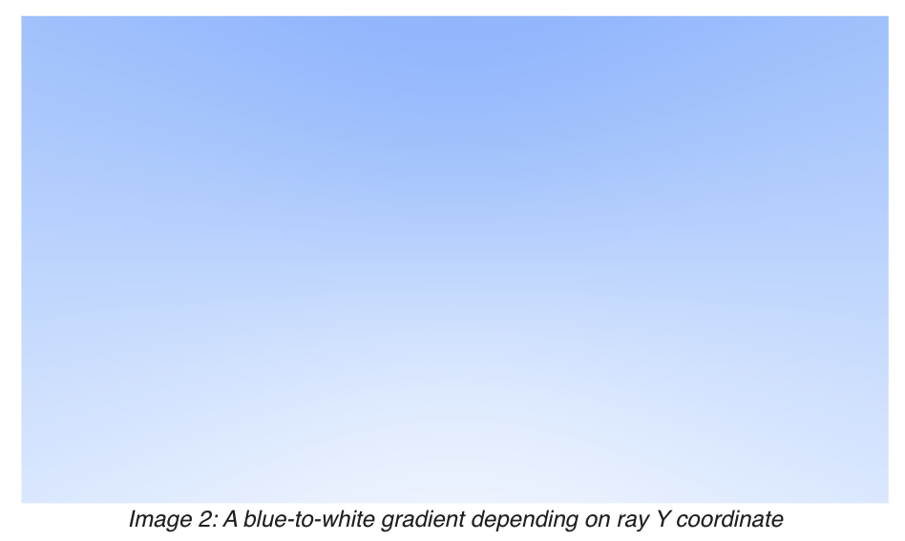
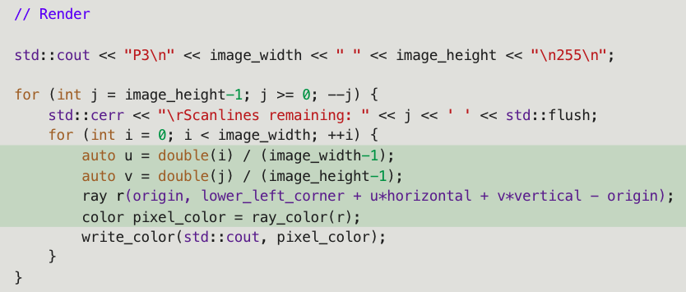
Codes
(Image + Camera +) Render

Slide 10
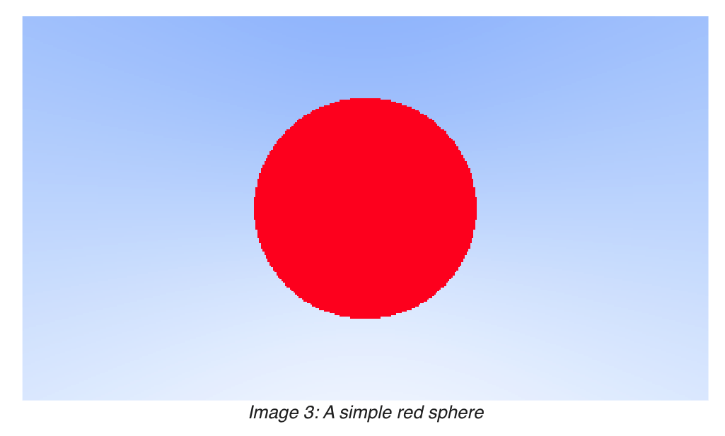
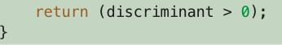
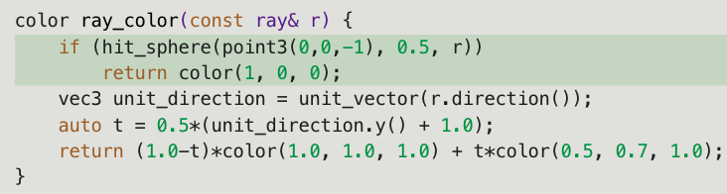
Adding a Sphere
Sphere: (𝑥−𝐶𝑥)^2+(𝑦−𝐶𝑦)^2+(𝑧−𝐶𝑧)^2=𝑟^2
Vector form: (𝐏−𝐂)⋅(𝐏−𝐂)=𝑟^2
Ray hits sphere: (𝐏(𝑡)−𝐂)⋅(𝐏(𝑡)−𝐂)=𝑟2 Where: 𝐏(𝑡)=𝐀+𝑡𝐛
=> 𝑡^2𝐛⋅𝐛+2𝑡𝐛⋅(𝐀−𝐂)+(𝐀−𝐂)⋅(𝐀−𝐂)−𝑟^2=0

Slide 11
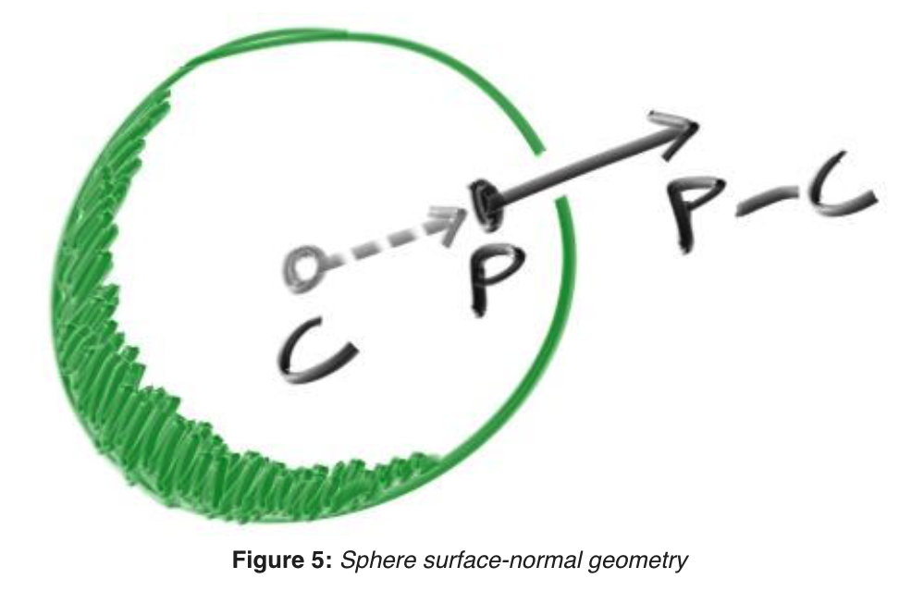
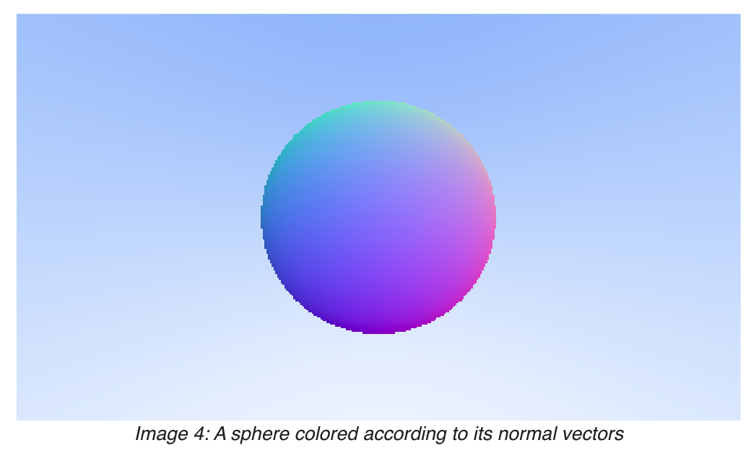
Surface Normals and Multiple Objects
Surface normal: vector that is perpendicular to the surface at the point of intersection
Code: configure hit_sphere to return smalltes t.

Slide 12
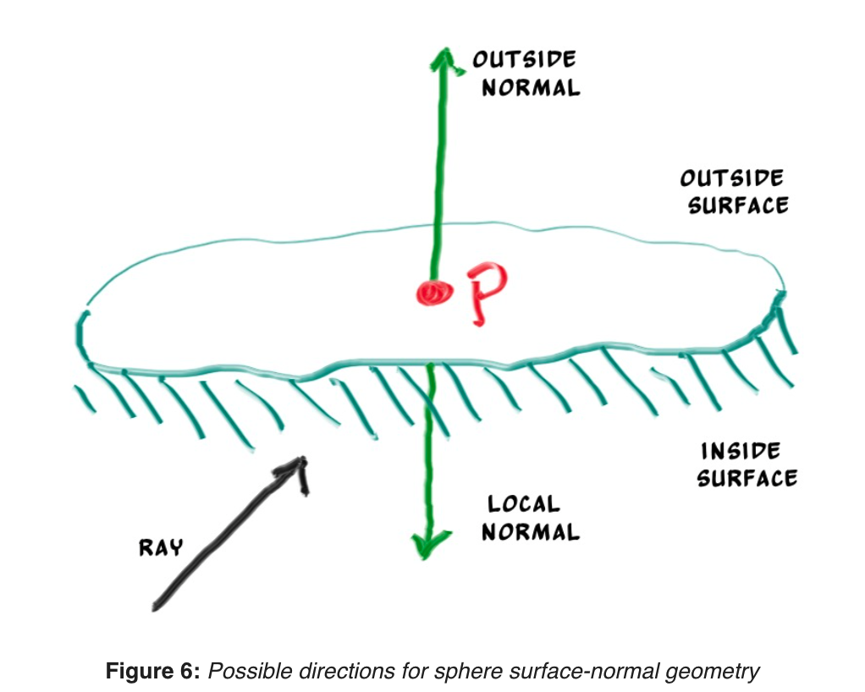
An Abstraction for Hittable Objects
Object, surface, hittable
Struct hit_record: P, N, t
Normal directions
Always out
Against ray

Slide 13
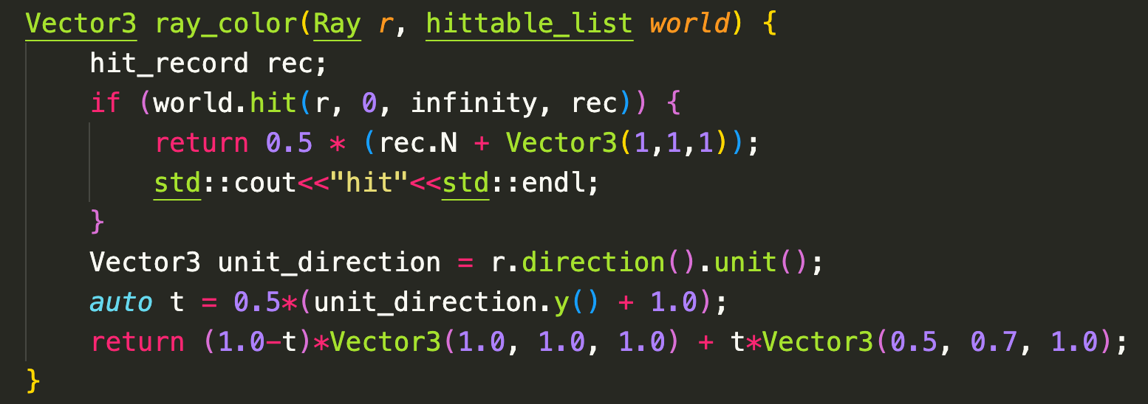
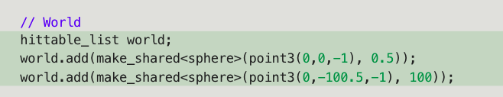
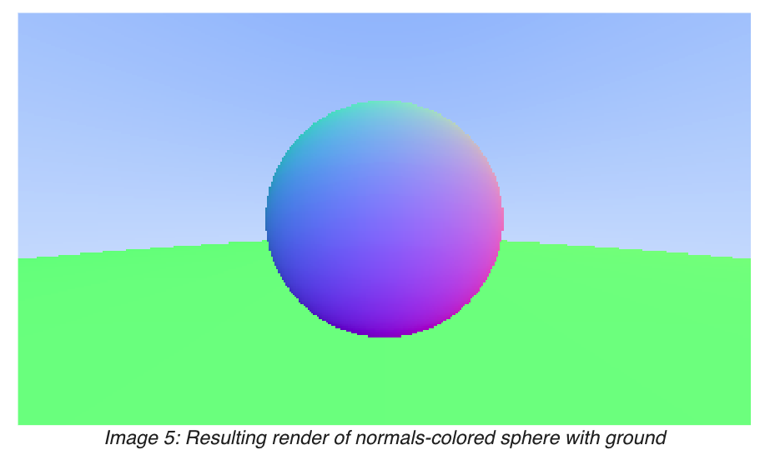
Add hittable_list

Slide 14
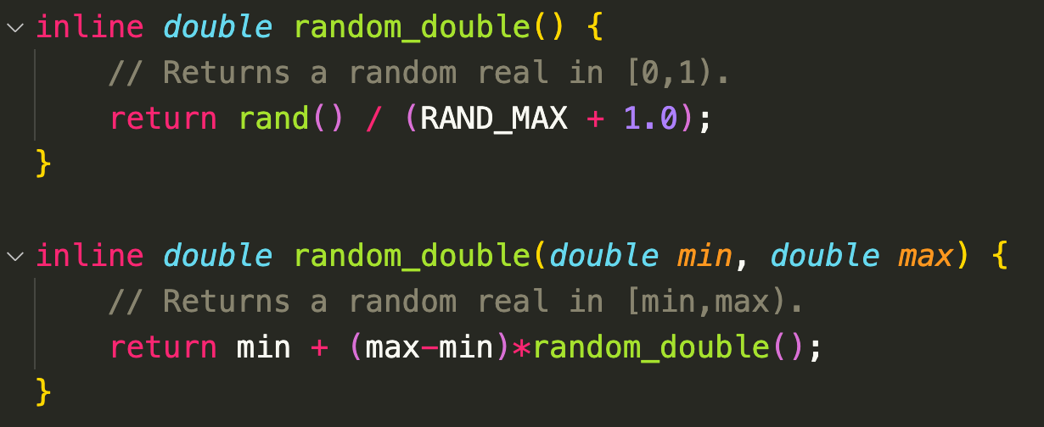
Antialiasing
Real camera: no jaggies along edges because the edge pixels are a blend of some foreground and some background.
=> averaging a bunch of samples inside each pixel
Canonical random number 0 <= r < 1
=> use rand() in <cstdlib> returns a random integer 0, RAND_MAX

Slide 15
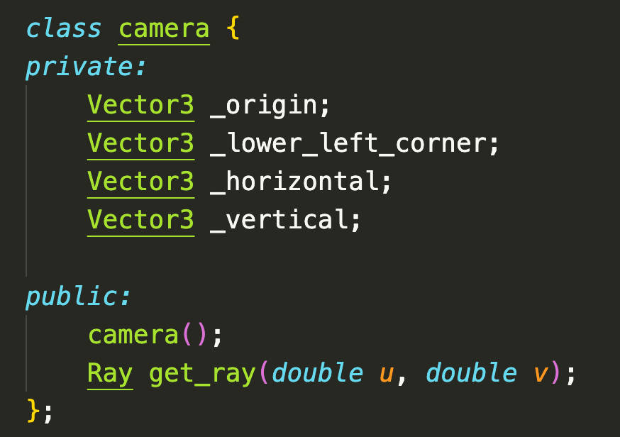
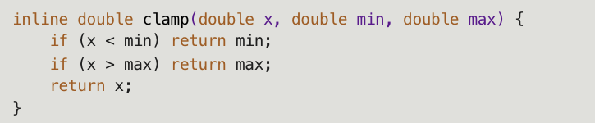
Add camera class
Write_color: add the full color each iteration, and then perform a single divide at the end (by the number of samples) when writing out the color

Slide 16
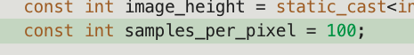
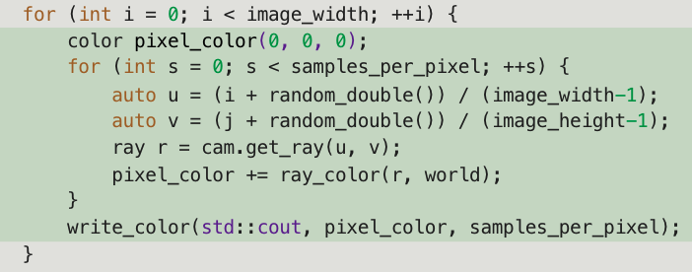
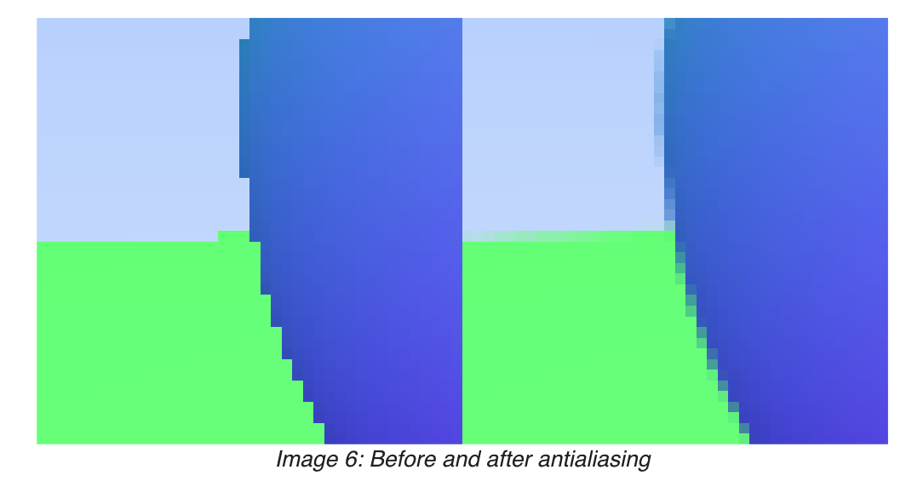
Add samples

Slide 17
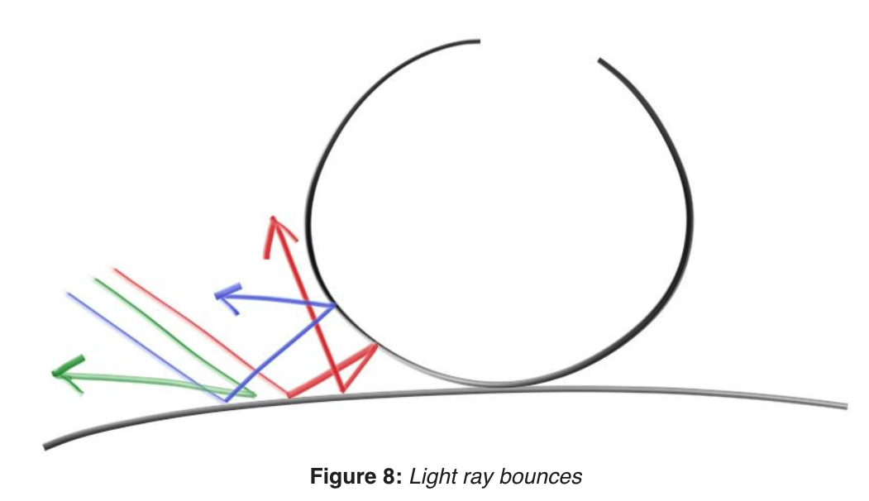
Diffuse Materials
take on the color of their surroundings, but they modulate that with their own intrinsic color
Light that reflects off a diffuse surface has its direction randomized

Slide 18
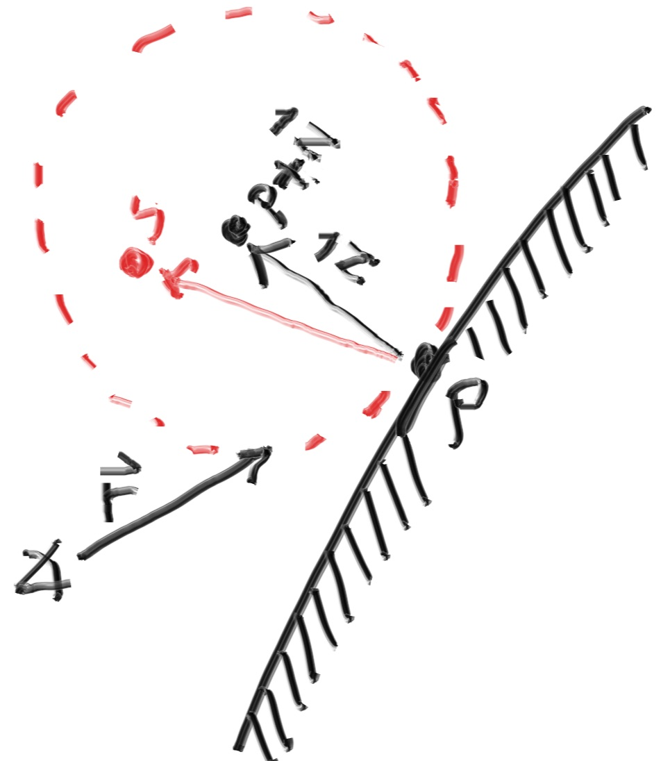
Diffuse Materials
Also absorbed. The darker the surface, the more likely absorption is.
algorithm randomizes direction will produce surfaces that look matte
The sphere with a center at (𝐏−𝐧) is considered
inside the surface, whereas the sphere with
center (𝐏+𝐧) is considered outside the surface.
Select radius on the same side as the ray origin
Pick random S inside this unit radius.

Slide 19
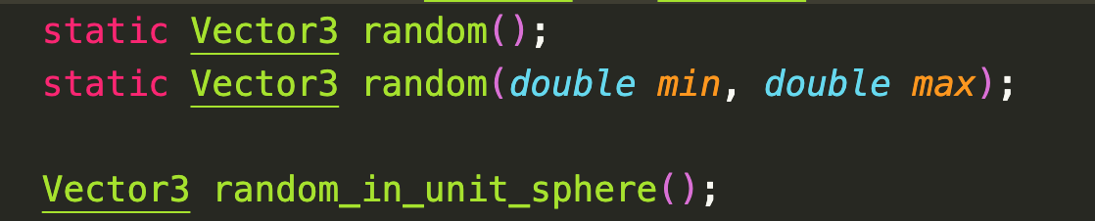
Pick random S.
Rejection method:
First, pick a random point in the unit cube where x, y, and z all range from −1 to +1. Reject this point and try again if the point is outside the sphere.

Slide 20
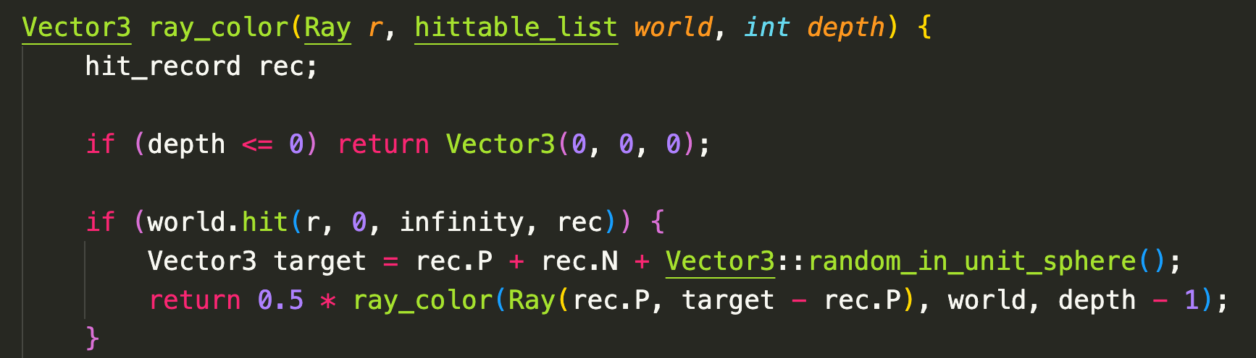
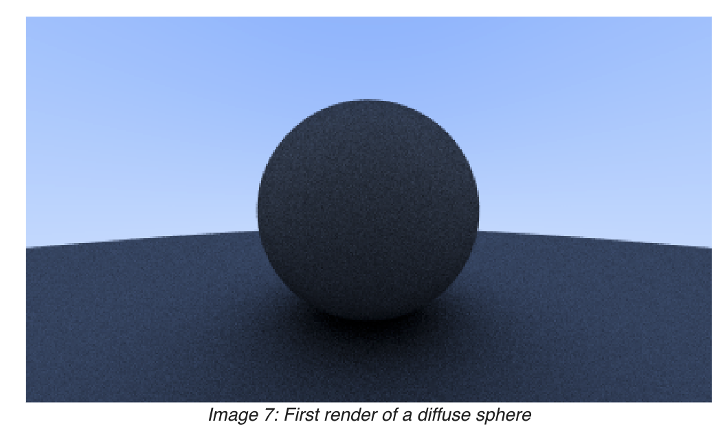
Recursive ray_color
Limit the number of child rays by depth.

Slide 21
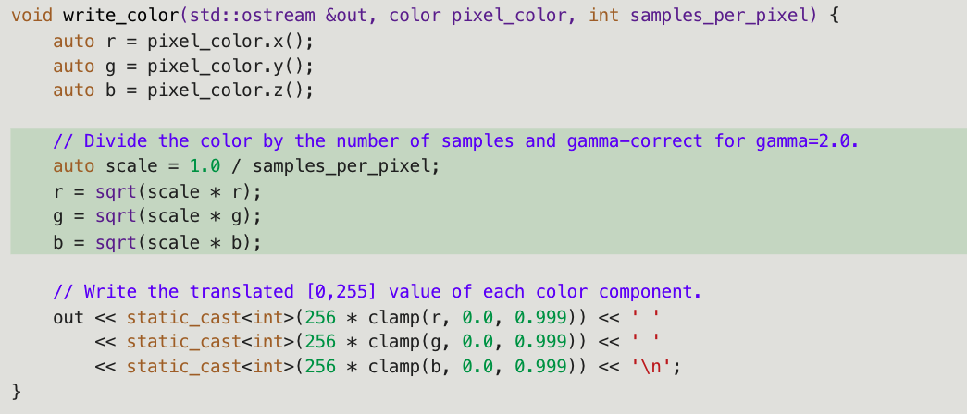
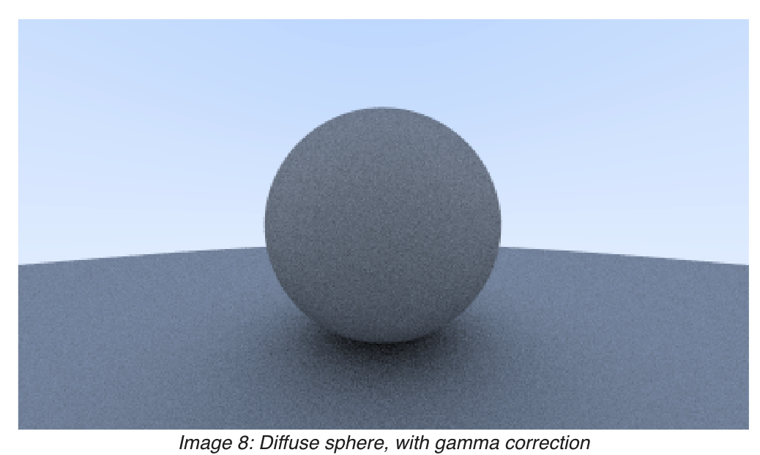
Gamma correction for accurate color intensity
meaning the 0 to 1 values have some transform before being stored as a byte
use “gamma 2” which means raising the color to the power 1/𝑔𝑎𝑚𝑚𝑎, or in our simple case ½, which is just square-root:

Slide 22
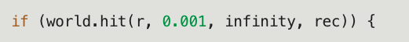
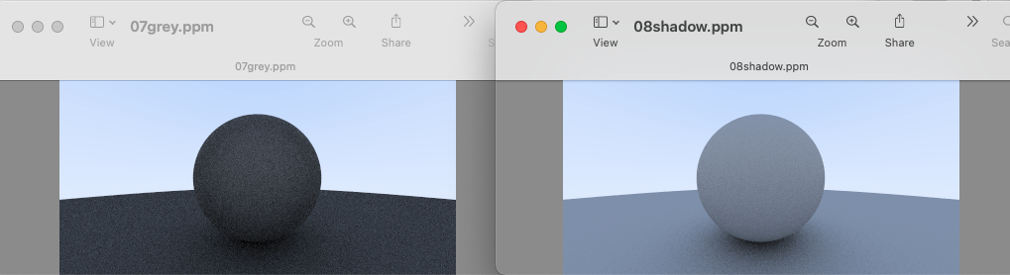
Shadow acne problem
Some of the reflected rays hit the object they are reflecting off of not at exactly 𝑡=0t=0, but instead at 𝑡=−0.0000001t=−0.0000001 or 𝑡=0.00000001t=0.00000001 or whatever floating point approximation the sphere intersector gives us. So we need to ignore hits very near zero:

Slide 23
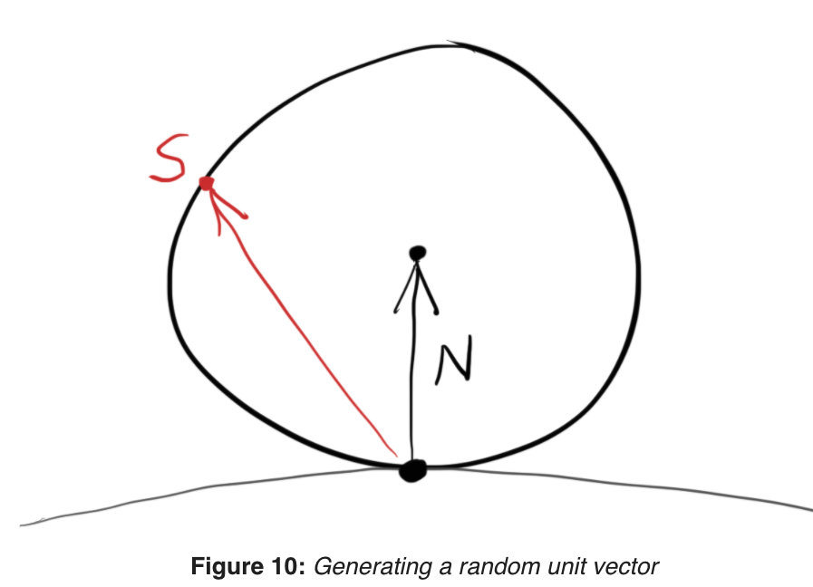
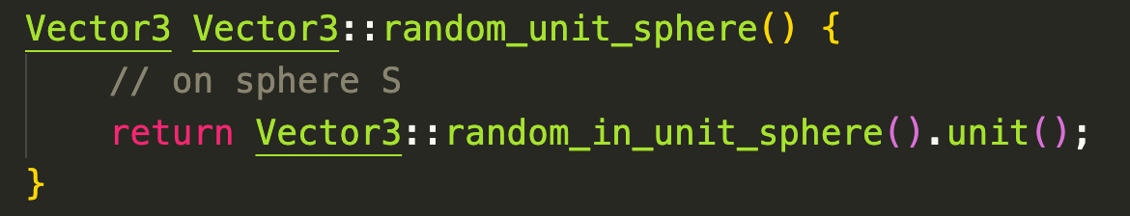
True Lambertian Reflection
Rejection method: scales by the cos3^(𝜙) where 𝜙 is the angle from the normal. This is useful since light arriving at shallow angles spreads over a larger area, and thus has a lower contribution to the final color.
Lambertian distribution: distribution of cos(𝜙).
has the probability higher for ray scattering close
to the normal, the distribution is more uniform.
picking random on the surface of the unit sphere,
offset along the surface normal.

Slide 24
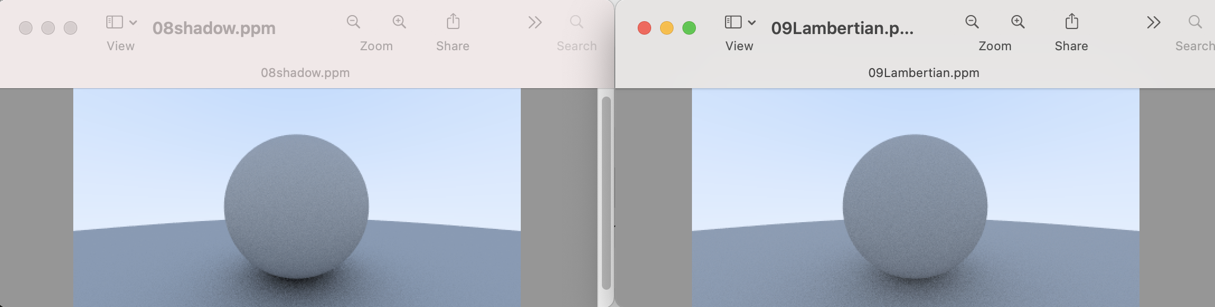
Differences
The shadows are less pronounced after the change
Both spheres are lighter in appearance after the change
<= due to the more uniform scattering of the light rays, fewer rays are scattering toward the normal, appear lighter because more light bounces toward the camera. the shadows less light bounces straight-up

Slide 25
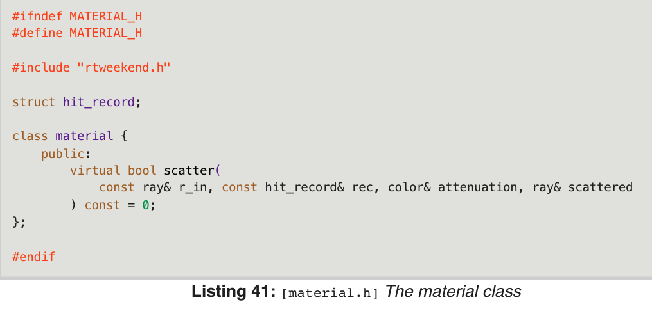
Abstract class for materials
Produce a scattered ray (or say it absorbed the incident ray).
If scattered, say how much the ray should be attenuated.

Slide 26
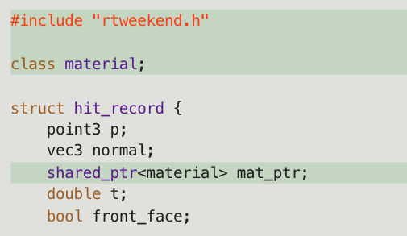
Material and hittable
Hittables and materials need to know each other so there is some circularity of the references. In C++ you just need to alert the compiler that the pointer is to a class, which the “class material” in the hittable class below does:
the material pointer in the hit_record
will be set to point at the material pointer,
when hits.
Add `shared_ptr<material> mat_ptr`
to Sphere.
[hittable.h] Hit record with added material pointer

Slide 27
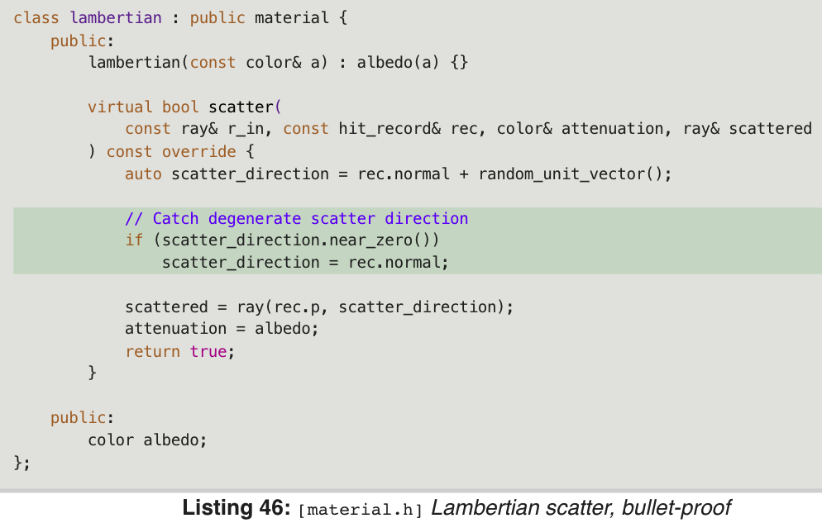
Modeling Light Scatter and Reflectance
scatter with some probability 𝑝 and have attenuation be 𝑎𝑙𝑏𝑒𝑑𝑜/𝑝.

Slide 28
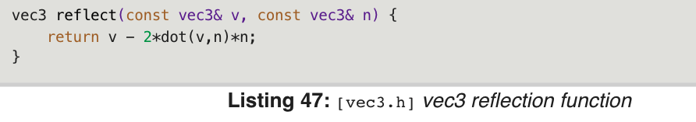
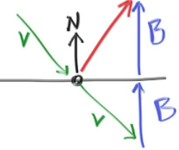
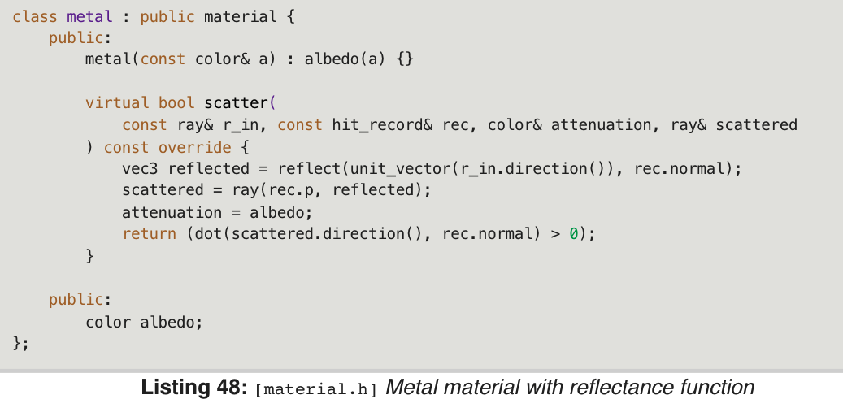
Mirrored Light Reflection

Slide 29
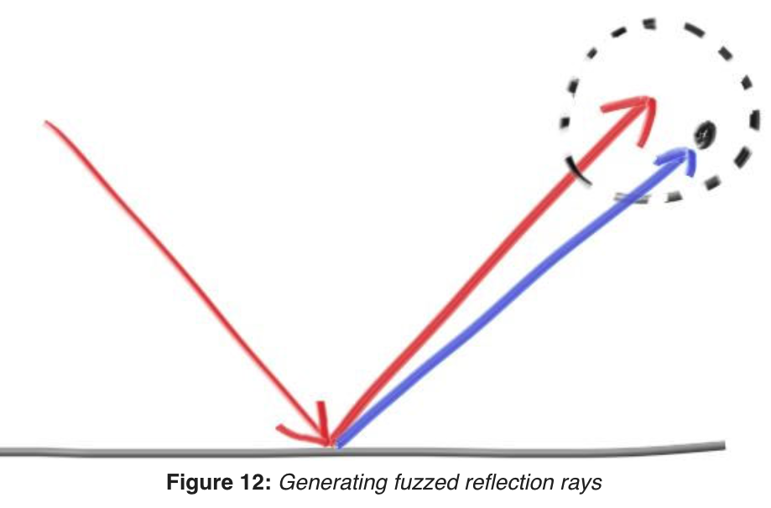
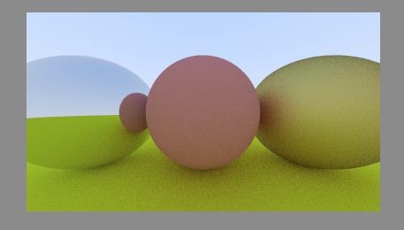
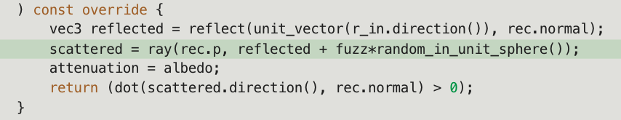
Fuzz Mirror
Fuzz = 0 & 1.

Slide 30
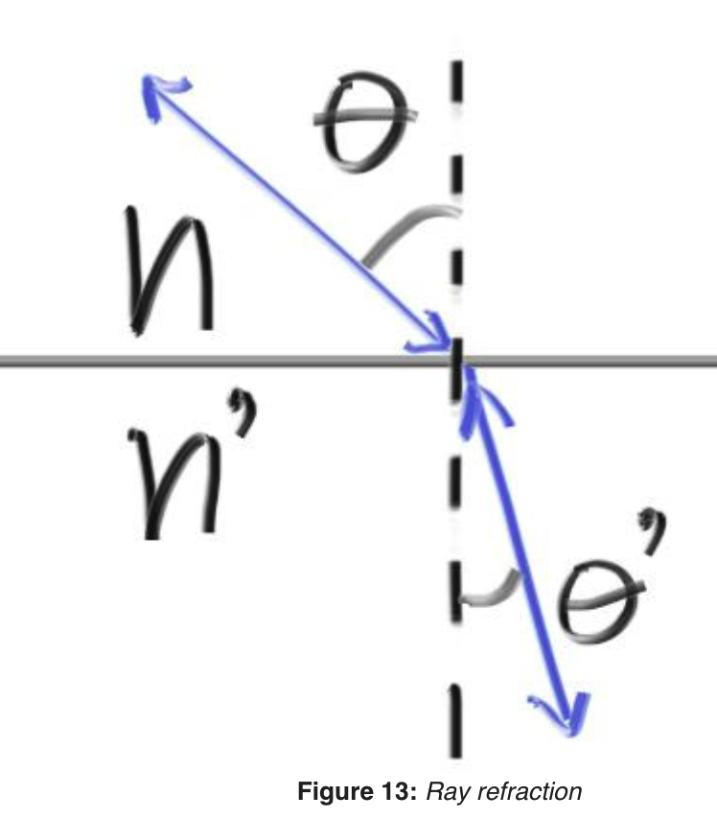
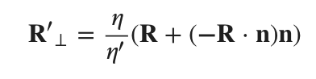
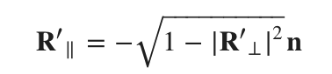
Dielectrics
Clear materials such as water, glass, and diamonds are dielectrics. When a light ray hits them, it splits into a reflected ray and a refracted (transmitted, 折射) ray. We’ll handle that by randomly choosing between reflection or refraction, and only generating one scattered ray per interaction.
Refraction described by Snell’s Law: 𝜂⋅sin𝜃=𝜂′⋅sin𝜃′
typically air = 1.0, glass = 1.3–1.7, diamond = 2.4

Slide 31
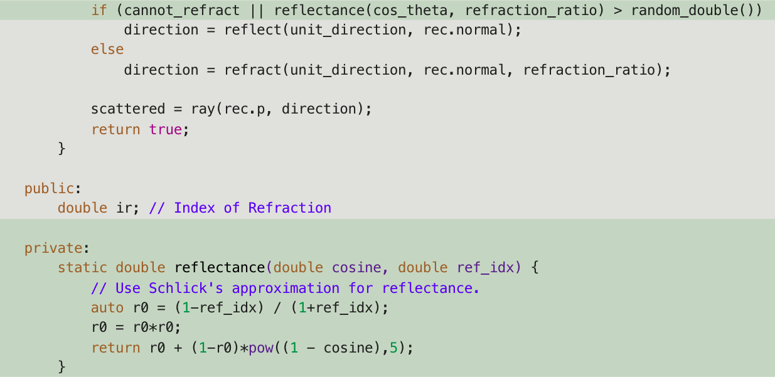
Schlick Approximation
real glass has reflectivity that varies with angle

Slide 32
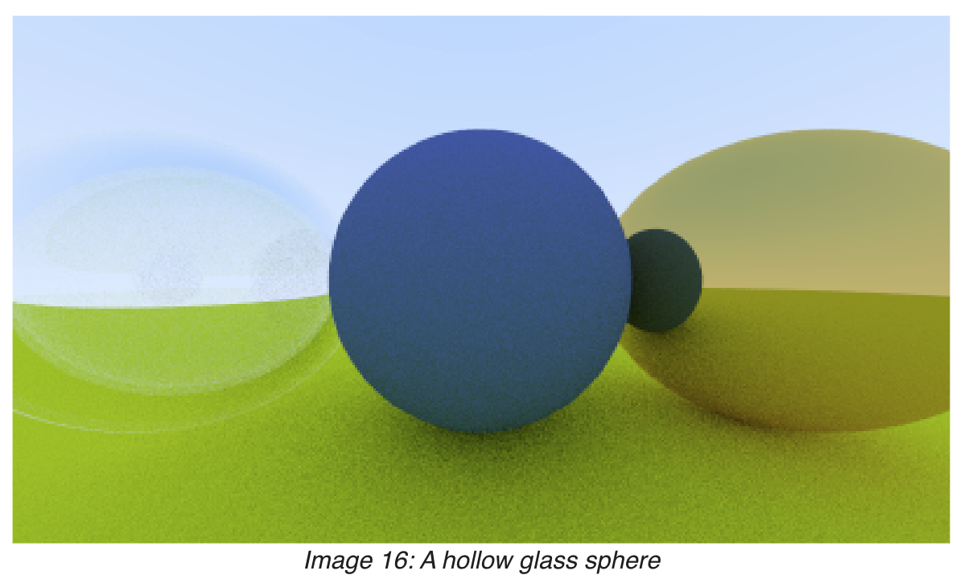
A hollow glass sphere
Negetive radius => surface normal points inward.

Slide 33


Positionable Camera
An adjustable field of view (fov), angle you see through the portal
x-axis is invisible in graph.

Slide 34

Camera
Position we place the camera as “lookfrom”
Point look at as “lookat”. // or direction to look other than point.
Roll (sideways tilt) of the camera. The rotation around the direction.
=> an “up” vector for the camera. Lie in the plane orthogonal to direction
=> and if use any up vector “vup” and project it on the plane.
vup, v and w in the same plane.

Slide 35

Camera

Slide 36
Defocus Blur
Focus distance: the distance between the projection point and the plane where everything is in perfect focus => 物距
Focal length: the distance between the projection point and the image plane => 像距, not that important.
In order to accomplish defocus blur, generate random scene rays originating from inside a disk centered at the lookfrom point. The related parameter is “aperture”.

Slide 37
Ray Tracing: The Next Week
https://raytracing.github.io/books/RayTracingTheNextWeek.html

Slide 38

Motion Blur
In a real camera, the shutter opens and stays open for a time interval, and the camera and objects may move during that time. Its really an average of what the camera sees over that interval that we want.
The basic idea is to generate rays at random times while the shutter is open and intersect the model at that one time. The way it is usually done is to have the camera move and the objects move, but have each ray exist at exactly one time.
Need to add time for ray.

Slide 39

Tracking the time of ray intersection
update the material::scatter() methods to account for the time of intersection:
scattered = ray(rec.p, direction, r_in.time());

Slide 40


Bounding Volume Hierarchies
ray-object intersection is the main time-bottleneck in a ray tracer
Key idea: find a volume that fully encloses (bounds) all the objects

Slide 41

Ray-AABB

